Slide 1
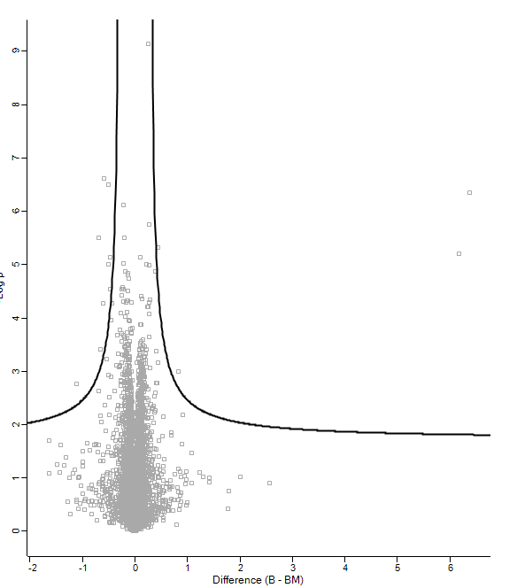
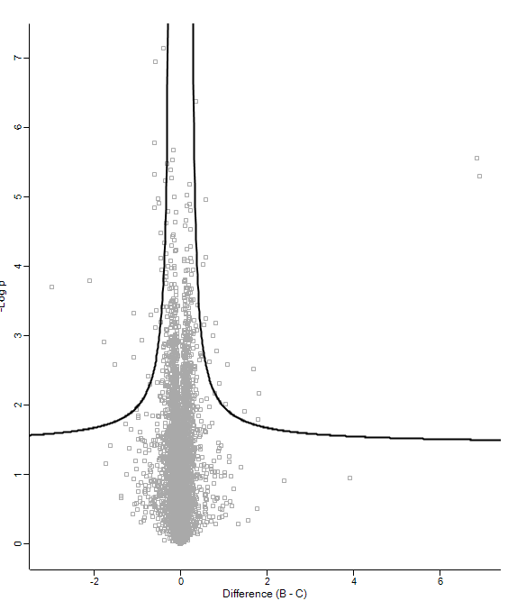
Smc6
Smc6
HBs
Nse1
HBc
HBs
Nse4
Hspg2
ITGA1
Nse4
HBc
Smc5
Hspg2
Smc5
Nse3
Nse3
Nse1
Nse2
ITGA1
Nse2
Smc5

